Slide 1


Credit Card Fraud Detection
Olisa Nwora

Slide 2

Objectives
Develop
Develop an advanced fraud detection system using machine learning.
Identify transactions that exhibit unusual patterns and potential fraud using the system.
Ensure the solution's capability to manage substantial data volumes effectively.
Provide
Provide valuable insights to the company for improved decision-making.
Determine the state with the highest susceptibility to fraud and pinpoint the key indicators of fraudulent activity.

Slide 3
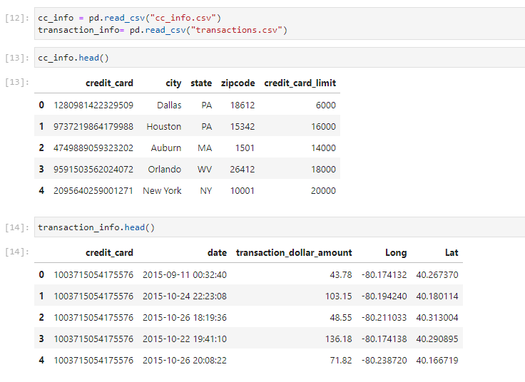
Sample of data used to build model.

Slide 4
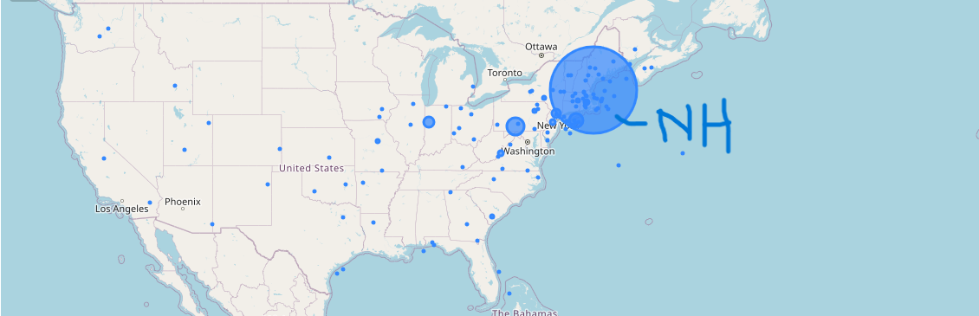
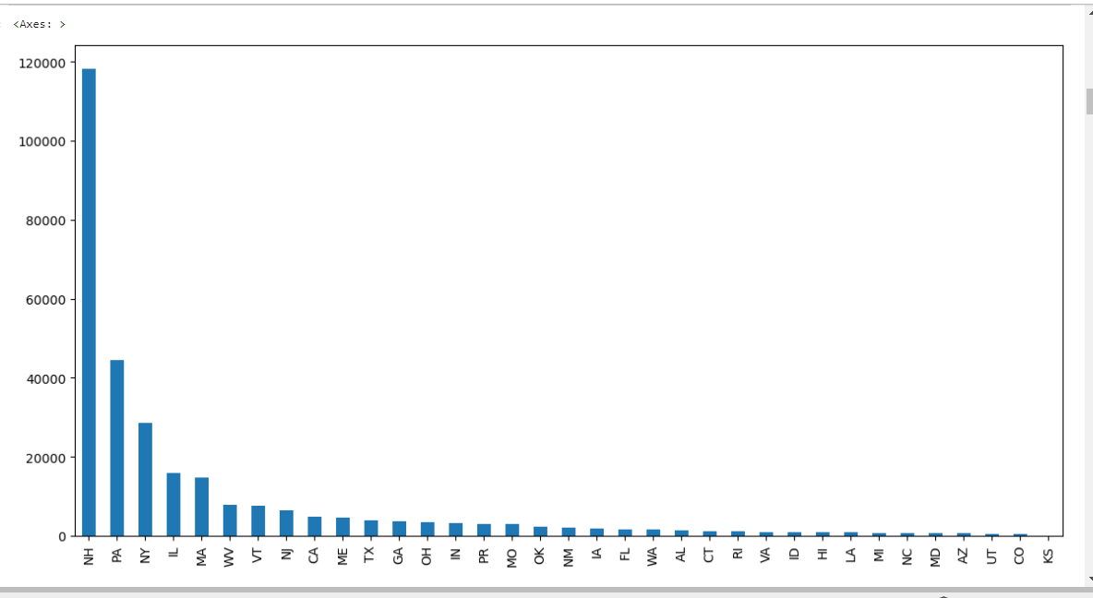


Judging from the visual evidence presented in both the map and graph, it is apparent that New Hampshire holds the highest transaction frequency or occurrence within this dataset. This signifies a heightened potential for credit card fraud to evade detection.

Slide 5
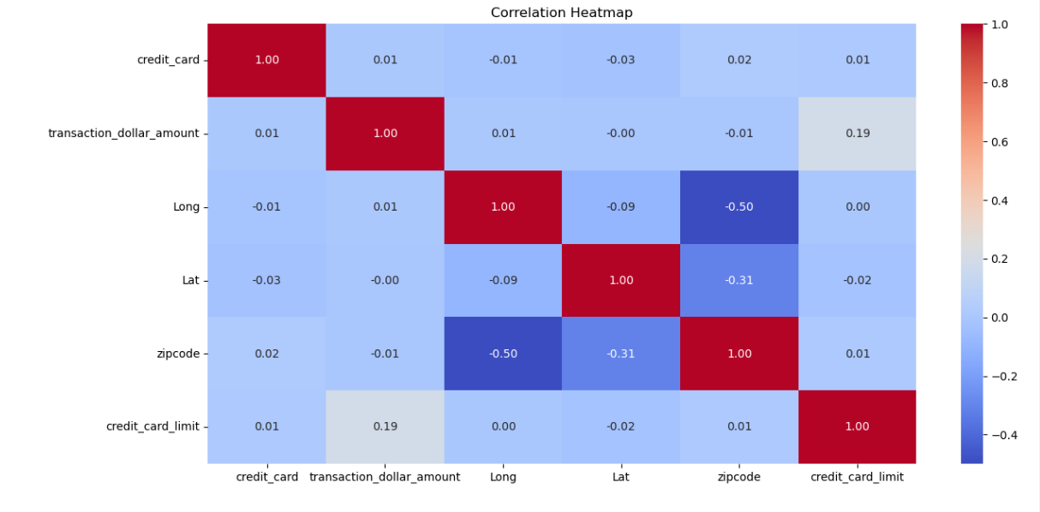
This heatmap shows the correlation of the two datasets prior to the fraud detection model. No major correlations besides the locations.

Slide 6
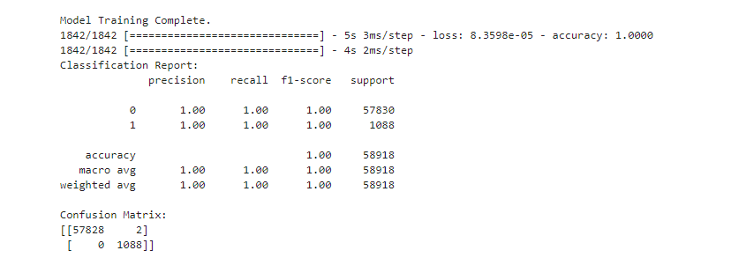
This is the classification report for the model. This confirms the model’s accuracy when making its observations.

Slide 7
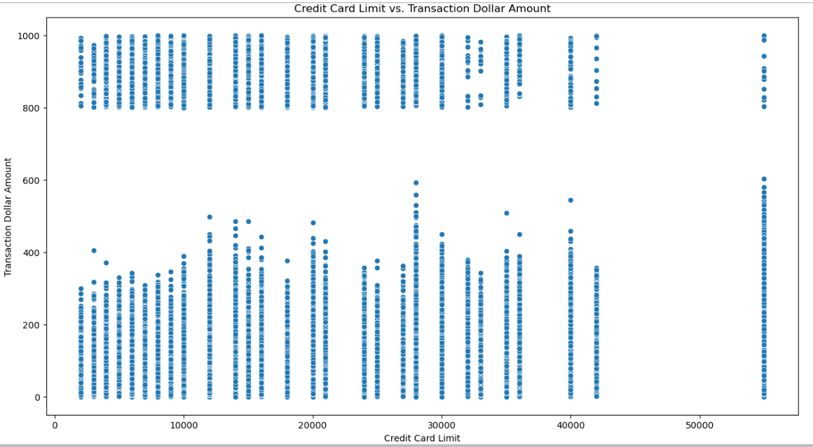
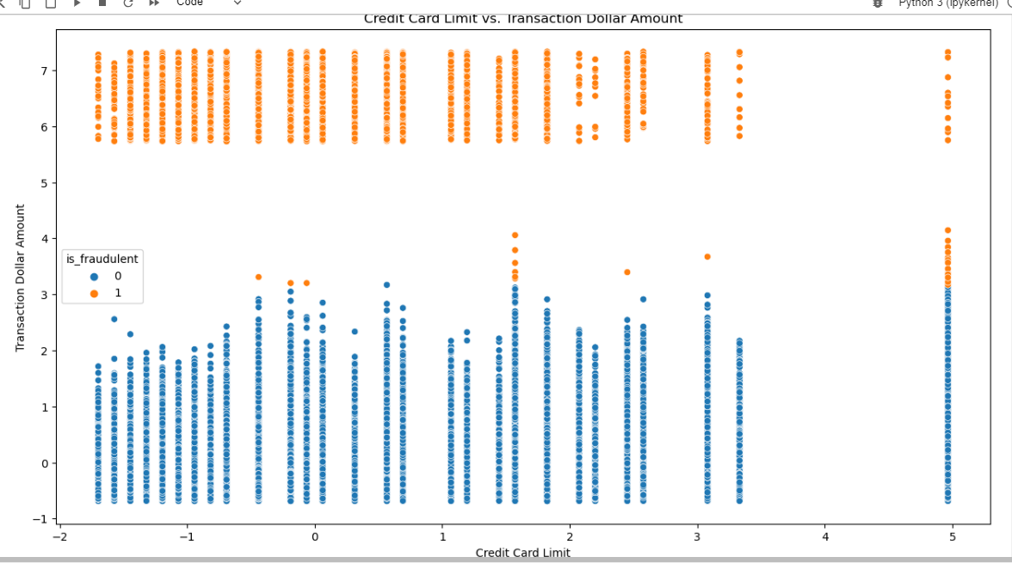
This graph represents the transaction amounts in relation to the credit card limit without the fraud detection.
This is the same graph with the implementation of the model.

Slide 8
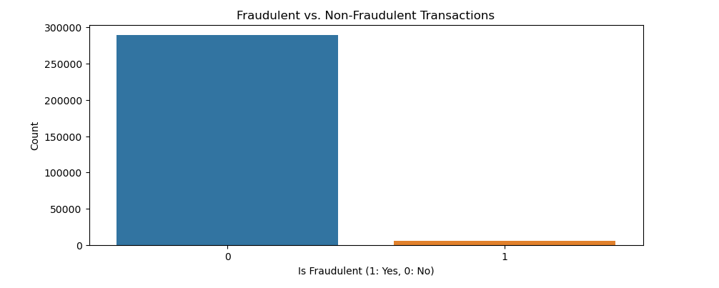
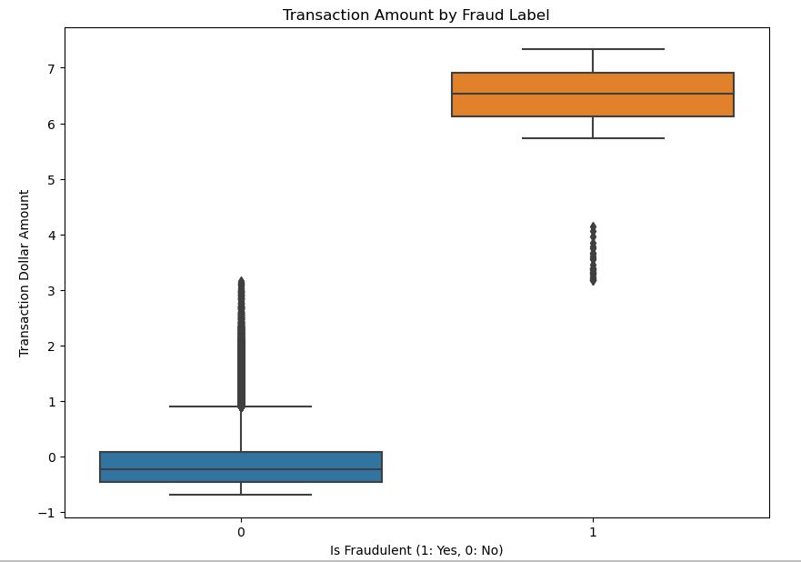


Utilizing the fraud detection model enables the determination of the ratio between fraudulent and non-fraudulent transactions. The analysis reveals that a fraction of less than 3% constitutes fraudulent transactions and that most, if not all occurs above the $500 dollar mark.

Slide 9
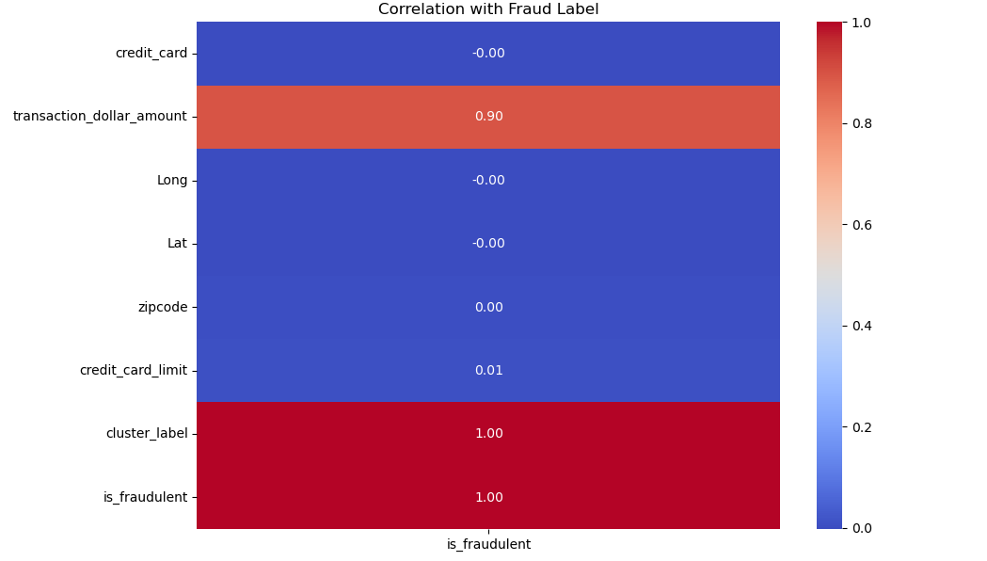




The heatmap illustrates the focus of the model on crucial factors for fraud detection. Given that fraudulent activities often involve larger transactions, the model exhibits heightened sensitivity towards transaction dollar amounts and credit card limits, with a particular emphasis on dollar amounts due to the limited relevance of credit card limits during fraud occurrences.

Slide 10
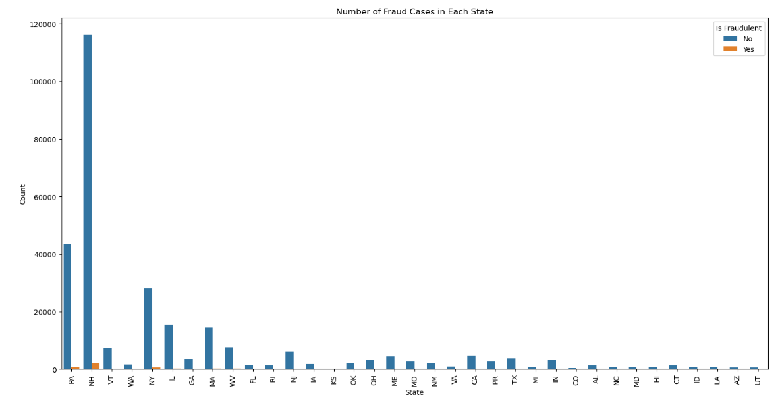

The graph depicts the incidence of fraud cases in each state as predicted by the model. Consistent with expectations, New Hampshire, characterized by the highest transaction volume, also exhibits the greatest number of fraud cases.

Slide 11

Conclusion
Using the built fraud detection model, it was found that with the more transactions that occurred, there was a higher chance of fraud taking place. The state of New Hampshire had the highest number of transactions along with the highest number of fraud.
The data indicates a pattern where fraudulent actions primarily occur in transactions exceeding $500, irrespective of the associated credit card limit. This highlights the model's emphasis on transaction amounts for fraud detection.
As an additional remark, this model's advantage lies in its capacity to mark potential fraudulent transactions, and its enhancement could involve preventing such fraud occurrences by imposing blocks on transactions that deviate from the user's typical behavior.

